Slide 1
Block Ram Image Viewer
Zoltán Ulrich
Notes:
Hello, my name is Zoltán Ulrich and I’m a fifth year computer science student.
My project’s name is BRIV short for Block Ram Image Viewer.

Slide 2
Where the project fits
The project uses the Nexys Board
It corresponds to the Image Acquisition and Processing category
It is quite modular with many parts easily reusable
Suitable as reference design
Notes:
The project belongs to the FPGA section of the contest because it uses the Nexys Board
and corresponds to the Image Acquisition and Processing category.
It is a rather complex project, with many modules, some of the modules are independent of the
design and are easily reusable.
I believe the design is suitable as reference for other projects.

Slide 3
Project Features
Displays images from the computer on a monitor connected to the board
2 display resolutions available
Mouse integration
Keyboard integration
Can display video stream from a webcam connected to the computer
Notes:
Images, received from the computer, are displayed on the connected monitor.
2 resolutions are available for display, 640x480 and 800x600 both at 60Hz refresh rate.
Mouse and keyboard have been integrated into the project. With the mouse cursor you can move the image on the screen
And from the keyboard you can control the image to be displayed and the effects to apply.
The project can display live video stream from a webcam connected to the computer which is also controllable with the keyboard.

Slide 4
Project Composition
The project consists of two major parts
- the digital design for the FPGA written in VHDL: describes the logic loaded into the FPGA to make the project work
- the software design of the application running on the computer, that manages the communication with the board and provides the board with images to be displayed
Notes:
The project consists of 2 parts:
- The digital design, which is a xilinx webpack project, with source code written in vhdl.
- C# application running on the computer to send the images.
I’ll start with the software and very briefly describe it, then I’ll present the hardware part which is far more interesting.

Slide 5
Software design
The software application is written in c#
Requires .NET Framework 2.0
Recognizes WIA compatible webcams
Uses the dcputil library
Source code is commented
Documentation extracted from xml style comments in the source code
Notes:
The software is written in c#, and requires .net 2.0.
If a wia compatible webcam is connected to the computer, the software recognizes it and can take images and live feed from it. The source code is commented and documentation in html format has been extracted from it.
The application uses the dpcutil library from the Digilent Adept Suite to communicate with the board.

Slide 6
Software application features(1)
Loads images from file and sends then to the FPGA
Gets images from a connected webcam and forwards them to the board
Polls the board for requests periodically
Resizes images, keeping aspect ratio, to fit in the FPGA memory
Browses the images in the current directory when requested
Notes:
The application loads images from file (supports bmp, jpg, gif, png and tif formats), can get images from the webcam and can play live video stream (which is basically just a sequence of images).
It sends the images using the dpcutil library to the board, and periodically polls the board for requests.
The application can browse the images in the folder of the last opened image using the keyboard.

Slide 7
Software application features(2)
Stores selected webcam ID: next time application is started uses stored ID
Offers the possibility to select the FPGA module to use from the ones registered with dpcutil
Maintains a list of recently accessed files
Notes:
The ID of the selected webcam is stored in the application settings, so next time when opened, it tries to connect to the last used webcam.
If there are more than one modules registered with dpcutil library, it provides the user the possibility to choose the desired module, and if there are no registered modules, then the module configuration window is opened, for the user to register one.
Also, it maintains a list of recently used files for easy access.

Slide 8
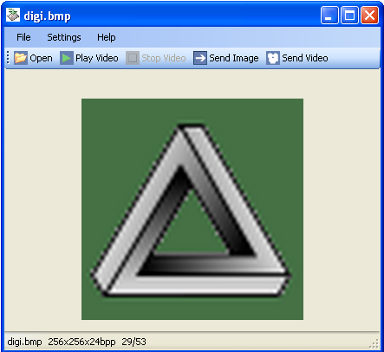
Main application form
Buttons in the toolbar for loading images, starting and stopping video feed, sending images to the board.
Status bar for displaying image name, dimension, bits per pixels, position in folder when browsing and frame rate when displaying video feed.
Browse images with space for next and backspace for previous.
Simulate 12 bits display by selecting “12bit Display” from the Settings menu.
Notes:
This is the main form of the application.
As you can see there is a toolbar with buttons to issue commands and a status bar for displaying information about the displayed image (like name, dimensions, bits per pixel and the position of the image in the folder).
For the webcam, the status bar displays the frame rate.
Can simulate 12 bits display for shown images by selecting an item in the settings menu.

Slide 9
How the application works(1)
Establishes a connection to the board through the dpcutil library
Loads images from file or from webcam and displays them on the main form.
When user clicks send image, it resizes the image to fit into the FPGA memory (max 16384 pixels) maintaining aspect ratio.
Transforms non 24bpp images to 24bpp
Rounds the width down to a multiple of 4.
Notes:
How to application works:
First it tries to establish a connection to the board
Then the user loads images from file or from the webcam
When the user clicks send image, the application resizes it to fit in the block ram memory of the Spartan (there can be a maximum of 16384 pixels in the image), transforms the image to 24bpp if it is not already, rounds the width of the image to a multiple of four (because of padding hidden pixels when this is not true) and then sends the image to the FPGA

Slide 10
How the application works(2)
When sending an image, first the width is sent, then the height and the actual image pixels follow, one color channel at a time, starting with the blue channel, the green and red.
Both the width and height are sent using a 4 byte transfer sequence:
Notes:
When sending the image, the width and the height are sent first.
These dimensions are sent using a sequence of tags and actual data on different epp address. I’ll wont go into details about this.
The image pixels are sent one color channel at a time starting with the blue, then green and lastly the red channel.

Slide 11
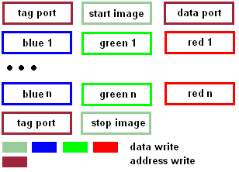
How the application works(3)
The image pixels are preceded by the start image tag and after all the pixels are sent the stop image tag is sent
Notes:
Previous to sending the pixels, the start image tag is send, and after all the image pixels are done, the stop image tag informs the board that the transfer is complete. Tags are not sent for every pixel because of efficiency reasons.

Slide 12
How the application works(4)
The webcam feed is just a sequence of images
Webcam feed is sent when the “send video” button is pressed and the video is started.
The frame rate is shown in the status bar
About 14 fps when sending to board.
Notes:
The video feed from the webcam is just a sequence of images that are sent to the board when the “send video” button is pressed and the video is started. The frame rate is shown in the status bar. On my computer I got around 14 frames per second when sending the video to the board.

Slide 13
Application requirements
.Net Framework 2.0
Windows Image Acquisition framework
WIA Library v2.0
Operating system:
Windows XP service pack 1 or better
WIA compatible webcam (optional)
Digilent Adept Suite
Notes:
These are the requirements for the software.
Microsoft .NET Framework 2.0
The Windows Image Acquisition framework (usually comes with the operating system)
The WIA Library v2.0 that can be downloaded from the Microsoft website.
The computer must run Windows XP Service Pack 1 or better.
Optionally a WIA compatible webcam can be used, but the application runs just fine, even if no webcam is present.
Digilent Adept Suite is needed.

Slide 14
Hardware digital design
Top level is schematic
Lower level modules are schematic or VHDL
Some very useful reusable modules: ps2interface, mouse_controller, keyboard_controller
Thoroughly commented
Instructive hdl coding techniques and device primitive instantiation examples.
Notes:
I’ll now describe the hardware design. Lots of modules, lots of interesting things to say, so little time. I’ll try to be succinct.
The top module is schematic and the lower level modules are either schematic or written in VHDL.
The design has some very useful reusable modules, like the ps2interface, the mouse controller and the keyboard controller.
You can just take these modules as source files, place them in your design and you are ready to use them without making any changes to their source code.
The source code is thoroughly commented, there are actually more comments than source code and there is a lot of code.
Useful HDL coding techniques are used like dcm chaining, finite state machine description, multistage computation and has some instantiated device primitives examples.

Slide 15
What the hardware does
Displays an image on the connected monitor
Interfaces a ps/2 mouse and displays a cursor on the screen: the mouse can move the image around
Interfaces a ps/2 keyboard that controls the image browsing, webcam, effects applied and the display resolution
Applies negative, grayscale or both effects to the displayed image
Notes:
What the hardware does:
Displays the images received from the computer on the monitor screen connected to it.
Interfaces a ps/2 compatible mouse and displays its cursor on the screen. With the aid of the mouse the image can be moved on the screen.
Interfaces a ps/2 compatible keyboard that can be used to control what image is displayed, to start and stop the video stream, to change the display resolution and to apply negative, grayscale or both effects to the displayed image.

Slide 16
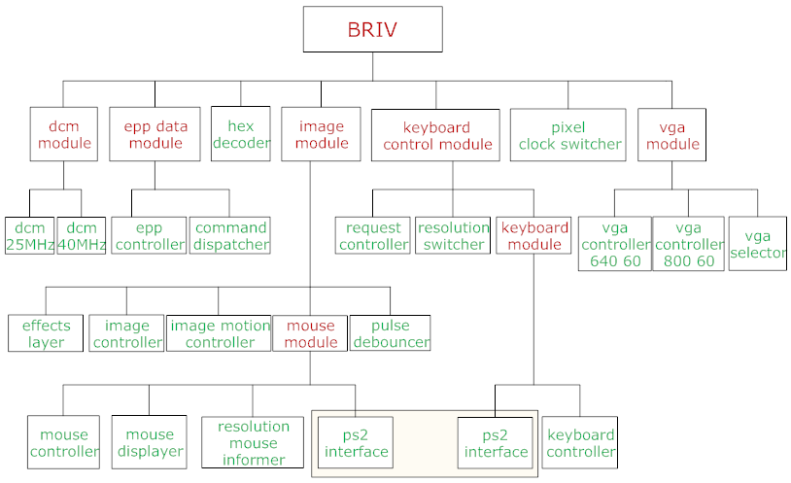
Design Modules Hierarchy
Notes:
This is the modules hierarchy. As you can see there are plenty of modules. Those represented in red are schematic and those in green are written in VHDL.
The highlighted area shows that two instantiations of the ps2interface are used, one for the keyboard module and the other for the mouse module.
Next I’ll briefly introduce you to the most important modules. We don’t have time for all of them and most likely you wouldn’t have the patience.

Slide 17
DCM module
Uses DCMs to generate the pixel clocks
One clock has 25MHz for the 640x480@60Hz resolution
The other clock has 40MHz for the 800x600@60Hz resolution
Reset chaining of DCMs to provide global reset
Notes:
The DCM module uses two DMC device primitives (that is Digital Clock Managers) to generate the pixel clocks needed for the vga controllers.
A 25MHz clock is generated for the 640 resolution and a 40MHz clock for the 800 resolution.
DCM clock outputs take a little time to stabilize, so to prevent the logic from functioning while these clocks are not valid, reset chaining of the DCM is used to provide the global reset line. While the DCM initialize, the reset is set high.

Slide 18
Epp Data Module
Contains the epp controller and the command dispatcher
Implements communication with the computer
Epp controller registers requests that are read periodically by the host by making an epp data read cycle
Command dispatcher interprets tags and data received and forwards them to the appropriate modules
Command dispatcher only forwards the most significant 4 bits of the color channel received
Notes:
The Epp Data Module implements the communication with the computer. It contains the epp controller and the command dispatcher modules. The epp controller implements the standard enhanced parallel port protocol and exchanges data with the host (the computer). It also registers requests from the request controller and forwards then to the host when it polls for requests.
The command dispatcher receives data from the epp controller, interprets the tags received and forwards the data to the appropriate modules. This is also where the conversion from the 24bpp image is made to 12bpp because it forwards only the most significant 4 bits of each color channel byte.

Slide 19
vga module
Contains two vga controllers for the two resolutions used and a vga selector to switch between their outputs
Outputs horizontal and vertical synchronization signals, horizontal and vertical counters and the blank signal delayed one pixel clock period
Notes:
The vga module contains the two vga controllers for the two resolutions used. It generates the horizontal and vertical synchronization signals and outputs the counters to determine the position of the currently displayed pixel on the screen. The blank signal is output and is high when the color beams in the monitor return to the left (or top) side of the screen. This is when the color outputs to the monitor are made 0.
The blank is delayed one pixel clock period to account for the pixel pipeline delay. It takes time to read the pixel from memory.

Slide 20
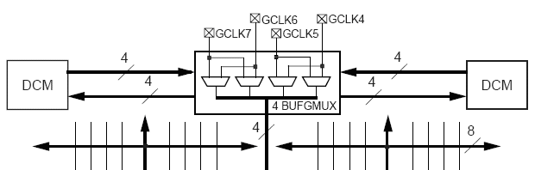
pixel clock switcher
Switches between the two pixel clocks depending on resolution
Uses BUFGMUX device primitives to switch between the clocks
Notes:
The pixel clock switcher switches between the two clocks received from the DCM module depending on the currently selected resolution. It uses a BUFGMUX primitive to do this. These devices are specially designed to switch clocks and output them on the global clock lines, but they have very strict using restrictions, because clock switching is a pretentious operation.

Slide 21
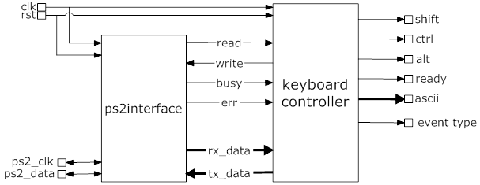
Keyboard module
Made of two parts: the generic ps2interface and the keyboard controller
The ps2interface is a generic module and implements the bidirectional ps/2 protocol
The keyboard controller is a client of the ps2interface
Notes:
The keyboard module is one of those reusable modules I spoke of earlier. It provides the rest of the design with
It is composed from 2 modules: the ps2interface and the keyboard controller.
The ps2interface is a generic module that implements the bidirectional ps/2 protocol.
It provides an easy way to interface it, as shown in the figure.
The keyboard controller is a client to this module, that provides the rest of the modules with key events from the keyboard.

Slide 22
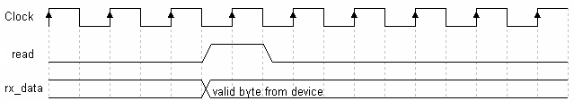
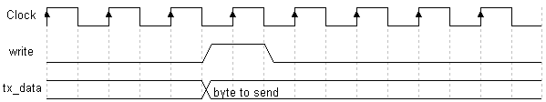
ps2interface(1)
Generic bidirectional ps/2 protocol implementation
Easy to use interface
Notes:
These timing diagram show how easy it is to interface the ps2 module.
When receiving data from the ps/2 device, the received byte is output on rx_data bus and the read signal goes high for one clock period.
When sending data to the device, the client places the byte on the tx_data input bus and sets the write signal high for one clock period.

Slide 23
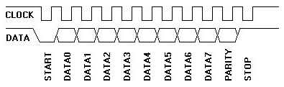
ps2interface(2)
Packs data to send into the ps/2 11 bits frame
Generates parity
Waits for acknowledge after sending
Extracts byte from the 11 bits frame when receiving data
Checks parity of received data
If error occurs, informs client
Notes:
The ps2 interface then wraps the byte in the ps/2 11 bits frame, generates the parity for it and then serially sends the bits to the device. After the frame is sent, it waits for acknowledge.
When receiving data, it checks the parity of the received byte.
At any time, if an error occurs, the err output is set high so the client is informed and can take appropriate action.

Slide 24
keyboard controller(1)
Initializes the keyboard
Receives scancodes from the ps2interface and outputs the corresponding ASCII code for that key together with the key event type
Keeps track and outputs the state of the shift, control and alt keys.
Keeps track of the keyboard leds and changes then appropriately when the num lock, caps lock or the scroll locks are pressed
Notes:
The keyboard controller initializes the keyboard by sending it the reset command, waits for the Basic Assurance Test to complete and then sets the keyboard typematic rate and delay. After initialization is complete it waits for scancodes from the keyboard.
It keeps track of the state of the shift, control and alt keys and outputs their state: ‘1’ if they are pressed or ‘0’ when they are released.
Also, the state of the LEDs is tracked and when num lock, caps lock or scroll lock is pressed, the state of the corresponding LED is toggled.
The keyboard controller outputs the ASCII code of the key pressed or released together with the event type.
There are two types of events: MAKE event, when a key is pressed or when it is held down and the BREAK event, when a key is released.

Slide 25
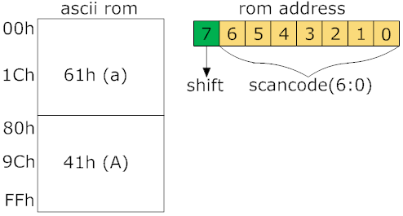
keyboard controller(2)
Outputs the ASCII code for the scan code received taking into account the state of the shift key
ASCII codes stored in 256x7bits ROM
Notes:
The ASCII code for the scancode received takes into account the state of the shift key.
For example, if the A key is pressed and the shift is released then the lower case a ASCII code is output. If the shift is pressed then the upper case A ASCII code is output.
This is done by making the most significant bit of the address into the scancode-to-ASCII ROM the state of the shift key, as shown in the figure.

Slide 26
Mouse controller(1)
Initializes the mouse
Tries to put the mouse in scrolling mode
Receives data packets from the mouse and tracks its absolute position
Outputs the state of the mouse buttons together with the mouse position on x and y axes and the z delta movement.
Inverts the y axis for the mouse to be easily used with a monitor.
Prevents the mouse position from leaving the visible screen area
Notes:
The mouse controller is probably the most important module, because it is very useful and highly reusable.
It tracks the position of the mouse, keeps and outputs its absolute position on x and y axes, outputs the state of the mouse buttons.
If the mouse has a wheel, places it in scrolling mode, and receives z movement information, that it outputs.
The mouse sends delta movements relative to the last position of the mouse and the controller adds this delta information to obtain the absolute position.
The adding is done using saturation, so that the mouse does not leave some bounds that can be set by other modules. This is useful for not allowing the mouse cursor to leave the visible screen area.
Also, the mouse uses as axes origin the lower-left corner and because the monitor uses the upper-left one, the controller inverts the y axis so that the clients don’t have to when displaying the cursor on screen.

Slide 27
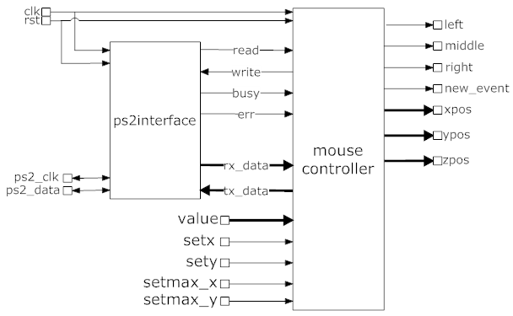
Mouse controller(2) - interface
Notes:
This is a figure showing how to interface the mouse controller, what output it provides for its clients and how the clients set the position of the mouse and its bounds.

Slide 28
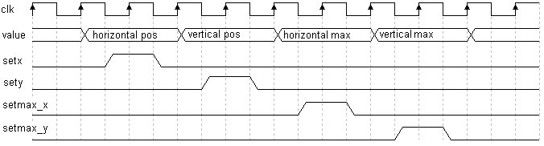
Mouse controller(3)
The position of the mouse can be set at any time
The bounds of the mouse can be set so to confide the mouse position within a desired rectangle
Notes:
The position of the mouse can be set at any time.
So can the bounds. You can set the maximum x and y position.
The minimum x and y position is always 0.
Setting the mouse position is used when changing the monitor resolution so that the mouse cursor appears centered on the screen. Setting bounds for the mouse position is also used when the resolution is changed, to confide the mouse inside the new rectangle the screen is.
These timing diagram show how easy is to set these values.
Just place the data on the value bus (10 bits width) an set high for one clock period the corresponding set signal.

Slide 29
Mouse controller(4) - initialization
Send the mouse the reset command
Wait for BAT test to complete
Try to put mouse in scrolling mode
Set the mouse resolution to 8counts/mm
Set the mouse sample rate to 40samples/s
Enable data reporting
Notes:
The mouse controller initialization procedure consists of the following steps:
Send the mouse the reset command
Wait for the mouse to send BAT test result and its ID, which is 0
Try to put the mouse in scrolling mode, by setting the sample rate to 200, then 100 and lastly 80. After this, read the mouse ID. If this ID is 0, then the mouse does not have a wheel. If it is 3, then the mouse entered scrolling mode and will include z movement data in the packets
Set the resolution to 8counts/mm
Set the sample rate to 40 samples/s
Enable data reporting. The mouse does not automatically send data packets after power-up or reset. Data reporting must be enabled for this to happen.

Slide 30
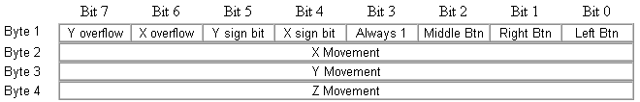
Mouse controller(5)
This is the packet format
3 bytes when no wheel, 4 bytes with wheel.
First byte contains state of the buttons, x and y movement sign and overflow status
Second byte is delta x movement (2’s complement)
Third byte is delta y movement (2’s complement)
Fourth byte is delta z movement, only least significant 4 bits
Notes:
The figure displays the packet format. It consists of 3 bytes when scrolling mode is disabled, 4 bytes otherwise.
The first byte contains information about the mouse button states, the x and y delta movement sign and their overflow status.
The second byte is the x delta movement, which is added to the last x position to obtain the present one. Similarly the y position is obtained from the third byte, but the value received is negated to invert the y axis.
The fourth byte (when in scrolling mode) contains z movement data and only the least significant 4 bits are relevant.
All movement data is represented in 2’s complement.

Slide 31
Image controller
Stores the received pixel data in the Spartan block ram.
Receives the image bounds from the image motion controller
When pixel position on screen is inside the image bounds, it reads the pixels sequentially from memory and sends them to be displayed
Sets the background white.
Displays image position information on the 7-segment displays
Stores color channel data in temporary register and then stores the whole pixel in memory
16kx12 bits memory used to store the image (all 12 block rams)
Notes:
The image controller stores the image in a 16kx12bits ram, that uses all the 12 block rams in the FPGA.
It keeps the color channel data in the pixel register until the pixel is complete and then it stores the content of this register in the memory.
The data format in the register is presented in the figure: first the 4 bits for blue, the green and red.
The controller uses the image position received from the image motion controller to read the pixels from memory when the counters from the vga module are inside the image bounds.
Also, it sets the background white and displays image position information on the 7-segment displays.

Slide 32
Image motion controller
Manages the motion of the image on the screen
Recognizes the mouse drag gesture
Centers new images on screen
Provides the image controller with the image bounds
Multistage computation of the image position when it’s dragged
Notes:
The image motion controller changes the position of the image based on mouse gestures.
When the mouse drags the image, the controller recognizes this gesture and moves the image after the mouse. Also when the mouse wheel is rolled the image is moved accordingly.
The image is moved on screen by providing new image bounds for the image controller.
When the width and the height of the incoming image are received, the controller centers the image on screen. This is also done when the resolution is changed.
When the image is dragged by the mouse, the controller computes the new image bounds in two stages.
During the first stage, from the mouse position it subtracts some saved differences and obtains the raw image bounds.
In the second stage, these values are normalized so that the image does not leave the screen bounds.
If this had been done in only one stage, the maximum clock period usable for this design would be significantly over 10ns, so the project couldn’t run at 100MHz.

Slide 33

Mouse displayer
Generates the mouse cursor, that is stored in a 256x2bits ROM.
Effectively implements a hardware layer for the mouse
Uses transparency so the cursor does look like a 16x16 square.
Notes:
The mouse displayer implements a hardware layer for the cursor.
The cursor is stored in a 16x16 ROM with 2 bit words.
It uses transparency not to appear as a square.
The cursor pixels replace those of the incoming image when the vga counters are inside the mouse square, except where transparency is used.

Slide 34
Effects layer(1)
Applies negative, grayscale or both effects to the incoming image pixels. This is a pixel level transformation.
Effects to apply are controlled through the keyboard
Does not apply the effect to the background or the mouse cursor.
For the grayscale effect each color channel is multiplied with an integer value, the products are added and the sum is divided by 512 (ignore the least significant 9 bits). This value is applied to each color channel.
Integers are:
- 154 for red
- 298 for green
- 60 for blue
Notes:
The effects layer module applies negative, grayscale or both effects to the incoming image on a pixel by pixel basis.
The effects to apply are selected through the keyboard.
It does not apply the effects to the background and because it is placed between the image controller and the mouse displayer, the effects do not apply to the mouse cursor.
For the grayscale effect, each color channel is multiplied with some integer (154 for red, 298 for green and 60 for blue) proportional to the wave length of the light with their color. The products are added and the sum is divided by 512. This is done by taking 4 bits above the least significant 9 bits.
Notice that the integers add up to 512, so there is no loss nor gain in the image brightness.

Slide 35
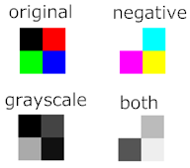
Effects layer(2)
Notes:
These is an example of an image and the how it looks with the effects applied to it.

Slide 36
Resources used
Logic Utilization | Used | Available | Utilization(%)
Number Of Slices | 1115 | 1920 | 58
Number Of Slice Flip Flops | 887 | 3840 | 23
Number Of 4 Input LUTs | 1766 | 3840 | 45
Number Of Bonded IOBs | 54 | 173 | 31
Number Of BRAMs | 12 | 12 | 100
Number Of Mult18x18s | 1 | 12 | 8
Number Of GCLKs | 4 | 8 | 50
Number Of DCM_ADVs | 2 | 4 | 50
Notes:
This the resource utilization table.
Notice that I use 50% of the Spartan’s DCMs and 100% of its block ram.

Slide 37
Project documents
Source codes with comments.
BRIV Design Project Report – describes the design of the hardware, presents and explains how every module works.
User’s manual – instructions to setup and use the hardware and the software
HTML documentation for the software project
Notes:
These are the documents that come with the project.
The source code comes with a lot of comments, it is where you will find all the hardware and software details.
The Design Project Report, takes you through all the hardware modules and explains them.
The User’s manual that contains instructions to setup and run both the hardware and the software.
The HTML documentation for the c# application extracted from the source code comments.

